Slide 1

Design and Implementation of Mobile Applications - 2024/25
Prof. Luciano Baresi
Watchee
Discover, Share, and Enjoy Movies Together
Matteo Laini - 10683821
Matteo Macaluso - 10656537

Slide 2

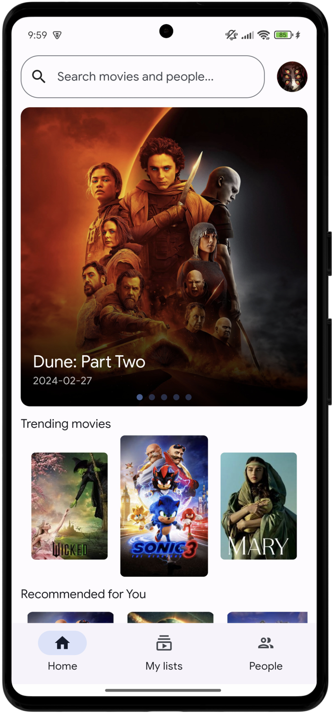
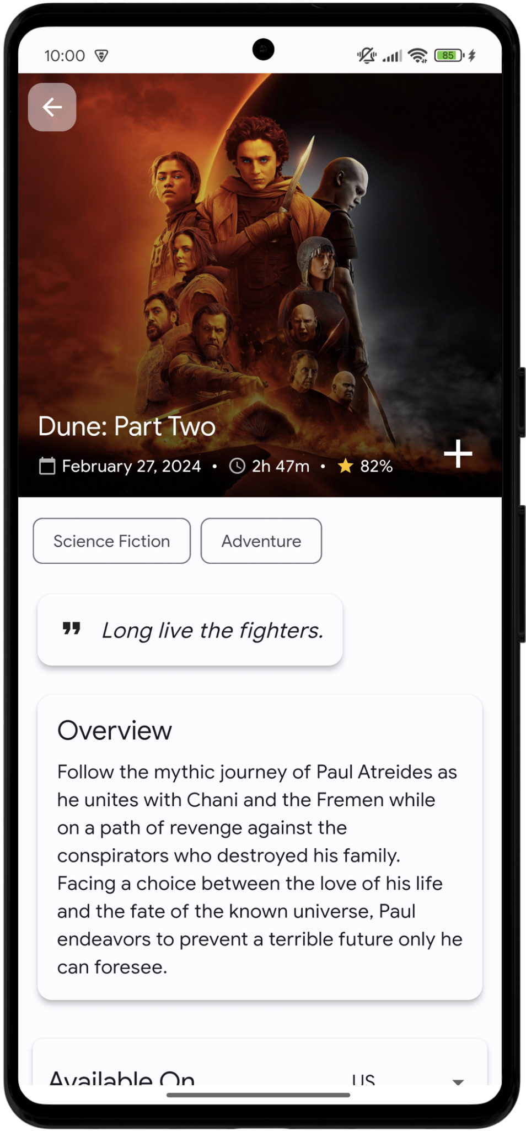
Introduction
Watchee is a comprehensive platform for movie enthusiasts
Track, share, and discover movies with a social-first approach
Easily access your favourite movies information

Slide 3
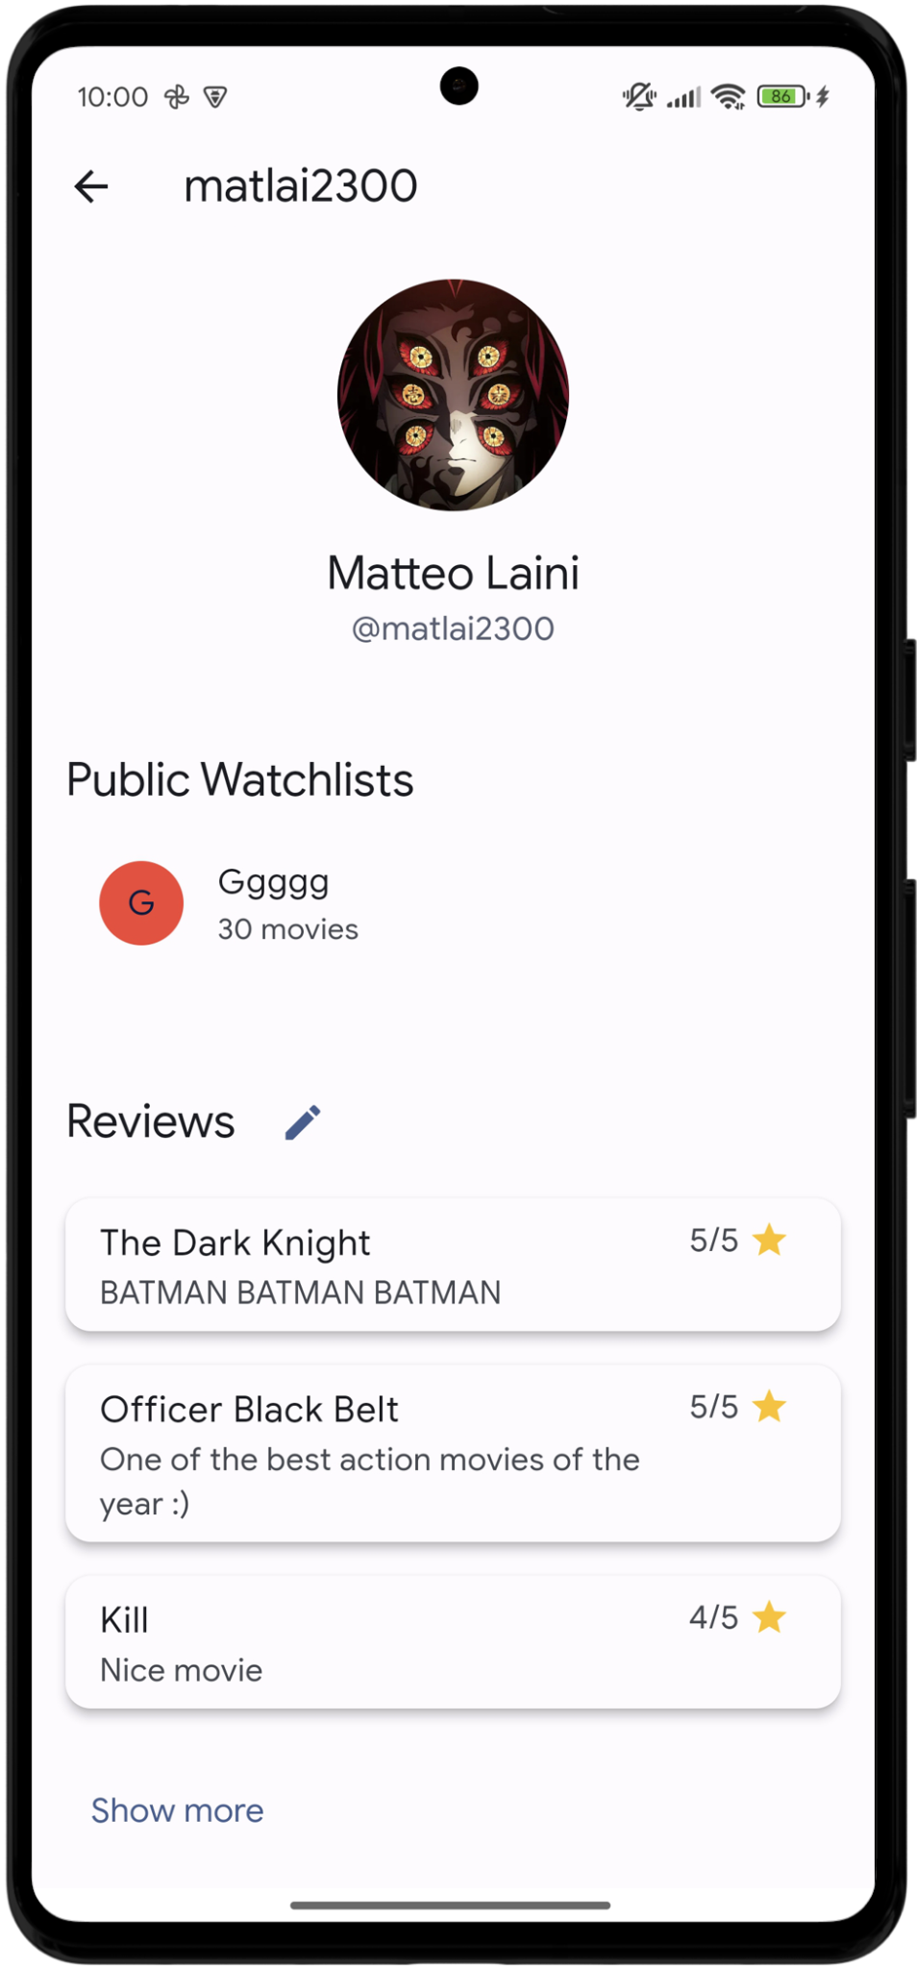
2. Core features
Movie discovery and recommendation
Movie details including cast and availability on streaming platforms
Custom watchlists creation with collaboration features
Social interactions (following users, sharing lists, posting reviews)
Push notifications (movie release date and social events)

Slide 4
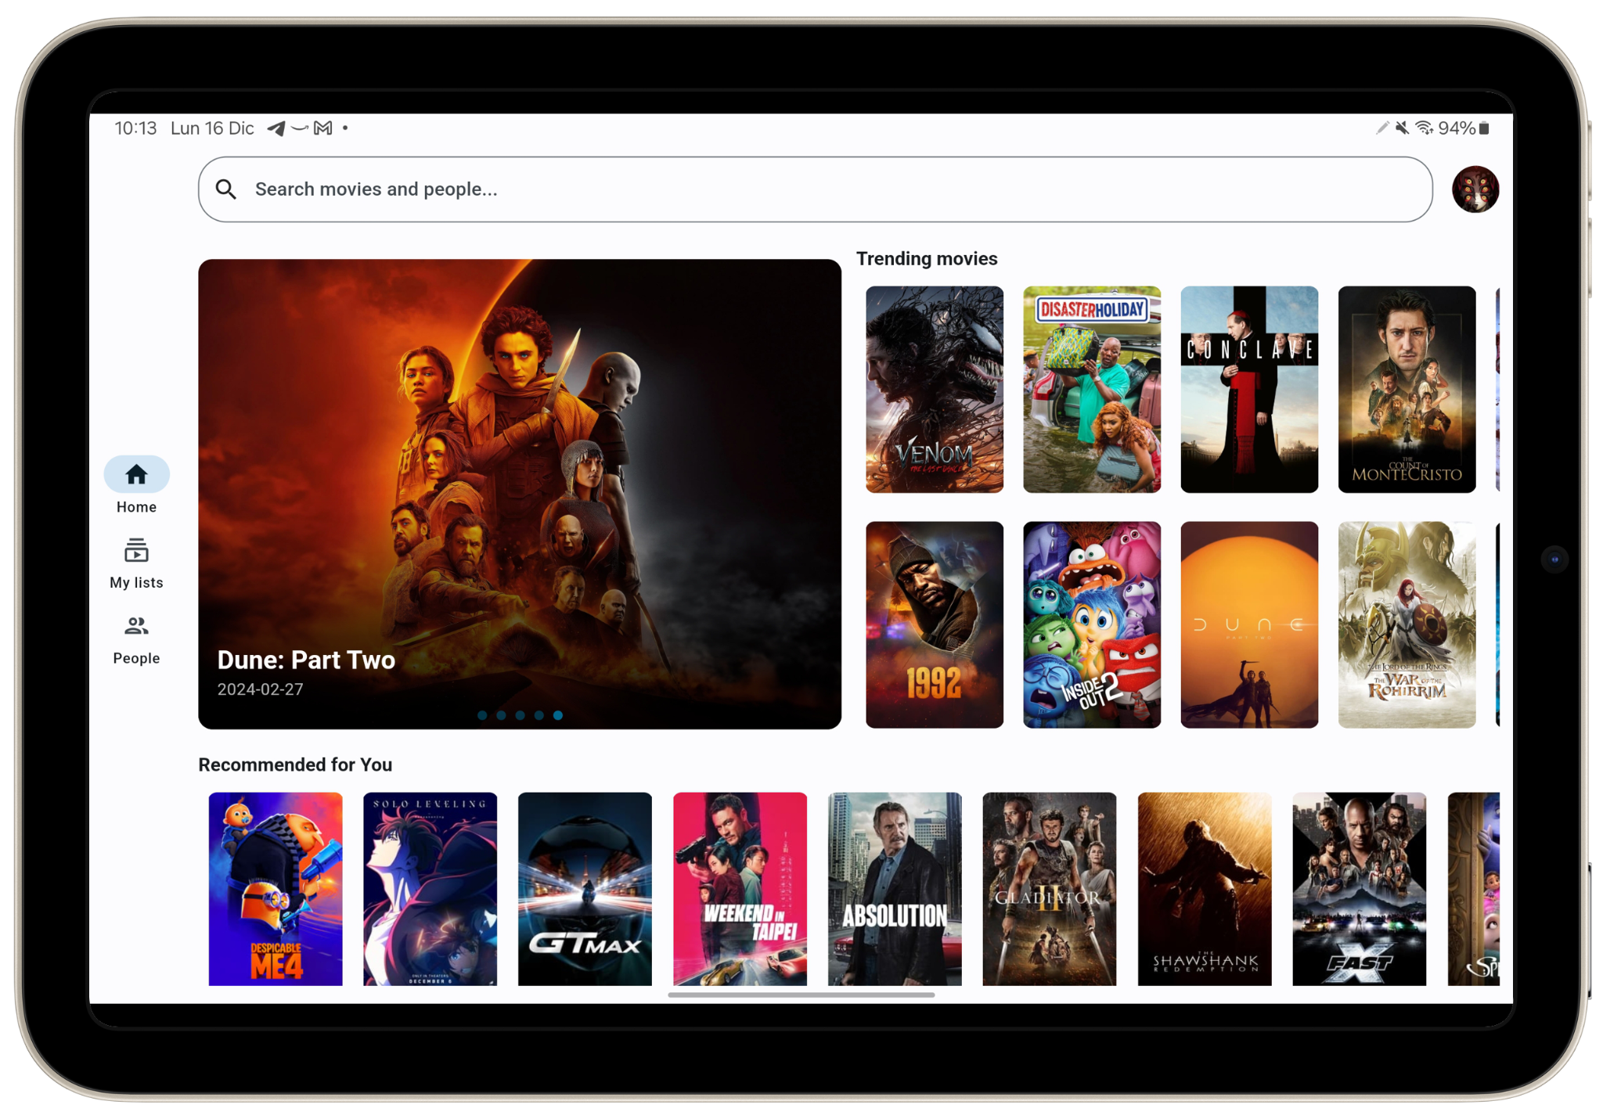
3. Design and UX
Material Design guidelines with dynamic theming and dark mode support
Optimized horizontal layouts for tablet users
Seamless navigation between related content

Slide 5


4. Architecture and external services
Authentication
Storage
Notifications
User data management
Real-time movie information
Cast details and filmography
Streaming availability by country
Trailers and additional contents

Slide 6

Thank you for the attention.

